Slide 1
The Five Paragraph Essay
a step- by- step introduction……….

Slide 2
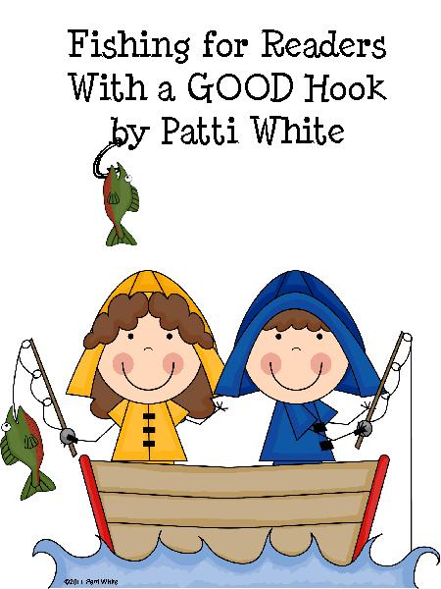
Step one to writing an Introduction
Pull your reader in with a hook. A great hook will make it almost impossible for the reader to put down the paper. Your first sentence should pull the reader in, making him or her want to read the essay because they are fascinated, intrigued, or even outraged.

Slide 3
What is a Hook?
An essay hook usually comes at the beginning of an essay's introductory paragraph and consists of an intriguing or vivid fact, detail or anecdote that introduces the essay topic.

Slide 4
So What? How Important is a Hook?
Writers use essay hooks to catch the reader's attention and compel him/her to keep reading.
Since many people will put down an essay after a boring introduction, a well-written hook often determines whether or not an essay is effective.
Writers can choose to refer back to the hook in the conclusion of their essay in order for a “full circle”/ stylistic effect.
Hooks are used in all forms of writing (fiction/non-fiction)

Slide 5
Types of hooks and the tricks to choosing the correct one…
Facts
Quotations
Anecdotes
Questions

Slide 6
Facts
Think about using an interesting fact or statistic as a hook. This interesting fact or statistic should surprise your reader. While the fact should be relevant to what you're saying, this is not the place to state the facts that you are using for evidence down in the body of your essay.

Slide 7
Examples of fun facts as hooks
China is going to spend $850 billion to clean up its water supply over the next decade.
Ancient Egyptians used heavy eye makeup to keep evil spirits at bay and to protect their eyes from infection.
A survey by Seventeen magazine in 2009 reveals some startling statistics about teen money management. Here are some of the highlights:
Working teens are saving up for the three Cs: clothes (57%), college (54%) and a car (38%).
Despite the recession, 75% of teens are receiving the same or more spending money this year than last year.
These facts should be something that connects to your topic and gets the reader interested.

Slide 8
Statistics and Facts Cont.
An essay on child labor laws might begin with the percentage of underage workers in your state or country.
An essay on the environment might warn the reader that it will only take a certain number of years for the earth's resources to be depleted.
This type of opening is intended to let your essay "hit the ground running," so to speak, and get straight to the point right away.
You may return to this fact later in your essay but it should stand on its own without a lot of explanation.

Slide 9
Quotation
When writing about literature, you might choose a quotation from the literary work itself or a quote from literary criticism about the piece.
When writing about a heated issue you can use a quotation from one of the sides of that issue.
A quotation introduction is truly effective when the quotation is unique, moving, and speaks directly to the heart of the essay's thesis. If your quotation cannot do those things then it should not be the lead-in for your essay.

Slide 10
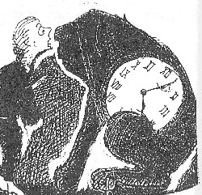
Quote Cont.
If I wanted to write an informative essay on how to recover from making a mistake:
“You must never feel badly about making mistakes," explained Reason quietly, "as long as you take the trouble to learn from them.” -Norton Juster, The Phantom Tollbooth
If I wanted to write an informative essay on how we can unite to improve our country:
President John F. Kennedy once said, "Ask not what your country can do for you, ask what you can do for your country." I think today's Americans have forgotten Kennedy's message. We expect our country to take care of us, but we are not taking care of our country.

Slide 11
Question
Using a question as the first sentence in your essay can help the reader interact with you as a writer. It makes the reader think about the subject of your essay and, possibly, relate that subject to his own life.
For instance, an essay on global warming might ask a reader to think about what the world would be like if no one ever recycled.
Or it might ask him to consider his own contribution to environmental efforts.
This is particularly effective if you are writing a persuasive essay. Draw the reader in with a question that is both relevant and provoking.

Slide 12
Question Cont.
An essay about literature might ask the reader if he has ever experienced something similar to the events in a novel.
The question opener, like the quotation opener, is effective only when the question specifically relates to the rest of the essay.
Questions can create personal interest in the essay, but be careful your question is not too general. For example, in an essay about cell phone use asking, “Do you own a cell phone?” is too general.

Slide 13
Question Cont.
"What would you do if you could play God for a day? That's exactly what the leaders of the tiny island nation of Guam tried to answer.“
"How do politicians buy votes? Assuming that money is the only way to grease palms, what favors do politicians promise in order to get reelected?"

Slide 14
ANECDOTE
An interesting little story
If you are writing a less formal paper, consider beginning with a relevant, humorous, or moving story. This will provide context and allow the reader to get to know you, or the person or thing you're writing about, a little bit better.
Note that in many cases it is not appropriate to use the first person in an essay, so double check before you the first person "I" in your hook.
Include sights, sounds, smells and other sensory images
make sure that the anecdote is short and to the point and relates to the main idea of your essay.

Slide 15
Anecdote cont.
When I was a young boy, my father worked at a coal mine. For 27 years, he made it his occupation to scrape and claw and grunt his way into the bowels of the earth, searching for fuel. On April 19, 2004, the bowels of the earth clawed back.“
"Sergei Filin was walking home on a cold Moscow morning when a man in black approached him. With his hand held behind his back, the man in black muttered something menacing. Before he knew what hit him, Filin was on the ground, struggling to grasp what had happened to him. He had been mugged."

Slide 16
Tips for Writing a Happy Hook
1. Write down possible examples or anecdotes that illustrate your topic.
If you've encountered surprising or interesting facts in your research/annotating, write these down as well.
If you have trouble thinking of interesting facts, brainstorm reasons why your essay topic is significant.
-Who does your topic affect?
- What impact does it have on the world?

Slide 17
Tips for Writing a Happy Hook
2. Read each potential hook into your introduction and determine which best leads into your thesis. Discard any which seem disconnected or irrelevant to your thesis.

Slide 18
Tips for Writing a Happy Hook
3. Make sure your hook is specific to your essay. If your hook is a general statement that could lead into countless essays, such as "Conflict is an inevitable part of life" or "Love is blind," rewrite your hook to pertain to your exact topic.
In addition, avoid common proverbs and clichés, since these will not draw in your reader.
Examples:
•All is fair in love and war: This cliché stands for the premise that you can do whatever you have to in order to capture the heart of your lover
•All’s well that ends well: This means that even if there were problems along the way, it doesn't matter as long as there is a happy ending
•Every cloud has a silver lining: This means that even when bad things happen, it may be possible to find some good in them

Slide 19
Tips for Writing a Happy Hook
Edit your hook so that it is approximately one to two sentences long.
In addition, ensure that the tone of your hook matches the tone of your essay.
-For example, a very formal essay should not have a hook that includes slang or contractions, while an informal essay may succeed with a humorous hook.
Go on to the next slide please

Slide 20
Now use the advice above and come up with your own hook for your persuasive essay. Please write this on a separate sheet of paper and keep it with your hook notes.
For this essay a shocking fact that supports your stance is usually the most effective (you may use your computers to find a fact as your hook)

Slide 21
Stop Here
Congratulations! You've finished your body paragraphs and your hook notes. Now, you need to read in your independent reading book.
If you do not have an independent reading book, which you should, then find one now!

Slide 22
Transitioning into your thesis statement
Continue explaining the hook, if necessary.
Some types of hooks can't just be left there, or they'll wilt and die. Some hooks need explanation. Quotations and questions, especially, require explanation much of the time. How you explain the quote can affect how powerful your thesis is, and how much it makes sense.
Begin transitioning to the thesis, perhaps by outlining your argument.
Introduce the main points or topics you will be writing about. However, be sure to find a way to connect how you started your essay to what your essay is about.

Slide 23
Examples of Explaining the hook
Example:
Hook: "'Your time is limited, so don't waste it living someone else's life.'"
Explanation: "In his famous Stanford commencement address, Steve Jobs explained how death was an important motivator that kept him focused and helped him fearlessly innovate."
Example:
Hook: "How often do you walk past a building and wonder what it looked like 100 years ago?"
Explanation: "Technology has allowed us to send a man to the moon, develop vaccines for ailments like polio, and — now — plumb the depths of history for visual clues to our architectural past."

Slide 24
Examples of Outlining the argument/paper

Slide 25
Time to Practice!
Now it is time to start your hook hunt
DIRECTIONS:
Grab a children’s book, or young adult novel, and open it to the first page read the first paragraph, or page, of each of the books and choose the best three hooks.
*You may want to look at several books- don’t just choose the first three you find.
record these hooks, along with the book titles and authors’ names, on the Hook Hunt worksheet
justify your choices by filling in the reason why you chose each hook.

Slide 26
Think Pair Share
Get with your assigned partner and take turns reading all 3 of the hooks you have found.
After you have each read all of your hooks- determine which hook of yours you each like the best and draw a STAR next to it.
PREPARE TO SHARE!

Slide 27
What Did We Notice?
Which hooks grabbed your attention the most? Why do you think they were so impactful?
What personal strategies did you use when creating your own hooks today? What have you used in the past?
Why is a “good” hook so important in writing?

