Slide 1
Poetry Terms and Examples

Slide 2
Types of Poetry
*Narrative: poetry that tells a story
From:
The Road Not Taken, by Robert Frost
Two roads diverged in a yellow wood,
And sorry I could not travel both
And be one traveler, long I stood
And looked down one as far as I could
To where it bent in the undergrowth;

Slide 3
*Dramatic: poetry in which the speaker is clearly someone other than the poet. Often in the form of dialogue
From:
The Raven, by Edgar Allan Poe
“Prophet!” said I, “thing of evil!—prophet still, if bird or devil!
By that Heaven that bends above us—by that God we both adore—
Tell this soul with sorrow laden if, within the distant Aidenn,
It shall clasp a sainted maiden whom the angels name Lenore—
Clasp a rare and radiant maiden whom the angels name Lenore.”
Quoth the Raven “Nevermore.”

Slide 4
*Lyric: poetry in which the poet expresses thoughts and feelings about a subject in a brief but musical way.
From
Sonnet Number 18, written by William Shakespeare:
Shall I compare thee to a summer's day?
Thou art more lovely and more temperate.
Rough winds do shake the darling buds of May,
And summer's lease hath all too short a date.

Slide 5
Forms of poetry
*Free verse: poetry that does not have a regular meter or rhyme scheme.
After the Sea-Ship by Walt Whitman
After the Sea-Ship—after the whistling winds;
After the white-gray sails, taut to their spars and ropes,
Below, a myriad, myriad waves, hastening, lifting up their necks,
Tending in ceaseless flow toward the track of the ship:
Waves of the ocean, bubbling and gurgling, blithely prying,
Waves, undulating waves—liquid, uneven, emulous waves,
Toward that whirling current, laughing and buoyant, with curves,
Where the great Vessel, sailing and tacking, displaced the surface;

Slide 6
*Haiku: a form of Japanese poetry that has three unrhymed lines; the first line has five syllables, the second line has seven syllables, and the third has five syllables
From:
Fight Club by Chuck Palahniuk
worker bees can leave
even drones can fly away
the queen is their slave

Slide 7
*Sonnet: a poem consisting of fourteen lines of iambic pentameter. There are two popular forms of the sonnet, the Italian (or Petrarchan) and the English (or Shakespearean).
From
Sonnet Number 18, written by William Shakespeare:
Shall I compare thee to a summer's day?
Thou art more lovely and more temperate.
Rough winds do shake the darling buds of May,
And summer's lease hath all too short a date.

Slide 8
*Limerick: a short, often humorous poem with a 5 line structure and a set rhyme scheme.
There was an Old Man of Nantucket
Who kept all his cash in a bucket.
His daughter, called Nan,
Ran away with a man,
And as for the bucket, Nantucket.

Slide 9
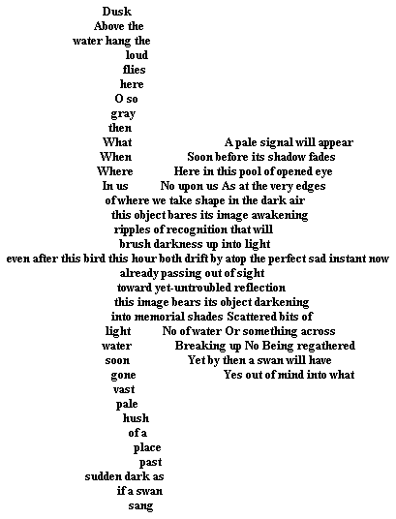
*Concrete poem: poetry in which the shape of the poem reinforces its meaning

Slide 10
*Quatrain: a poem with four line stanzas (usually has a regular rhyme scheme)
From:
Hope is the Thing with Feathers, by Emily Dickinson
"Hope" is the thing with feathers
That perches in the soul
And sings the tune without the words
And never stops at all,

Slide 11
*Tanka: a form of poetry that has five unrhymed lines: with a syllable pattern of five, seven, five, seven, and seven syllables in each line.
To live is to break by Ueda Miyoji
To live is to break
One's heart for the sake of love;
A couple of doves,
The beaks touching on their way,
Are stepping out in the sun.

Slide 12
*Villanelle: a nineteen-line lyric poem written in five three-line stanzas and ending in a four-line stanza with a patterned rhyme scheme.
Do Not Go Gentle Into That Good Night Dylan Thomas (1914-1953)
Do not go gentle into that good night, Wild men who caught and sang the sun in flight,
Old age should burn and rave at close of day; And learn, too late, they grieved it on its way,
Rage, rage against the dying of the light. Do not go gentle into that good night,
Though wise men at their end know dark is right, Grave men, near death, who see with blinding sight
Because their words had forked no lightning they Blind eyes could blaze like meteors and be gay,
Do not go gentle into that good night, Rage, rage against the dying of the light.
Good men, the last wave by, crying how bright And you, my father, there on the sad height,
Their frail deeds might have danced in a green bay, Curse, bless, me now with your fierce tears, I pray.
Rage, rage against the dying of the light. Do not go gentle into that good night,
Rage, rage against the dying of the light.

Slide 13
Poetic Devices
*Alliteration: the repetition of initial consonant sounds in words such as “rough and ready.”
From
The Raven By Poe
Once upon a midnight dreary while I pondered weak and weary

Slide 14
*Assonance: the repetition of vowel sounds without the repetition of consonants. “My words like silent raindrops fell.”
Fire and Ice by Robert Frost
Some say the world will end in fire,
Some say in ice.
From what I’ve tasted of desire
I hold with those who favor fire.
But if it had to perish twice,
I think I know enough of hate
To say that for destruction ice
Is also great
And would suffice.

Slide 15
*Onomatopoeia: the use of a word whose sound suggests its meaning, as in clang, buzz, or twang.
The Highwayman BY ALFRED NOYES
[...] And the highwayman came riding—
Riding—riding—
The highwayman came riding, up to the old inn-door.
He’d a French cocked-hat on his forehead, a bunch of lace at his chin,
A coat of the claret velvet, and breeches of brown doe-skin.
They fitted with never a wrinkle. His boots were up to the thigh.
And he rode with a jewelled twinkle,
His pistol butts a-twinkle,
His rapier hilt a-twinkle, under the jewelled sky. [...]
Tlot-tlot; tlot-tlot! Had they heard it? The horse hoofs ringing clear;
Tlot-tlot; tlot-tlot, in the distance? Were they deaf that they did not hear?
Down the ribbon of moonlight, over the brow of the hill,
The highwayman came riding—
Riding—riding—

Slide 16
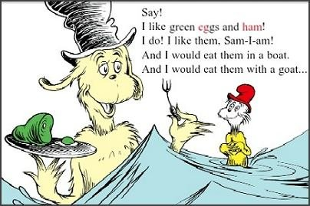
Poetic Construction
*Rhyme: the similarity or likeness of sound existing between two words

Slide 17
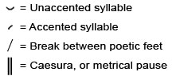
*Meter: the patterned repetition of stressed and unstressed syllables in a line of poetry.

Slide 18
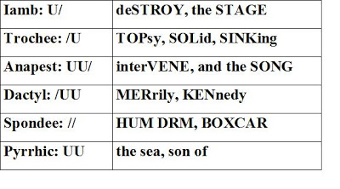
*Foot: the smallest repeated pattern of stressed and unstressed syllables in a poetic verse.

Slide 19
*Verse: a metric line of poetry. It is named according to the kind and number of feet composing it. (Example: most of William Shakespeare’s poetry is written in iambic pentameter – each line has five iambic feet)
u / u / u / u / u /
Shall I compare thee to a summer’s day?

Slide 20
*Stanza: a division of poetry named for the number of lines it contains
Where the Sidewalk Ends by Shel Silverstein
There is a place where the sidewalk ends
And before the street begins,
And there the grass grows soft and white,
And there the sun burns crimson bright,
And there the moon-bird rests from his flight
To cool in the peppermint wind.
Let us leave this place where the smoke blows black
And the dark street winds and bends.
Past the pits where the asphalt flowers grow
We shall walk with a walk that is measured and slow,
And watch where the chalk-white arrows go
To the place where the sidewalk ends.

Slide 21
*Refrain: the repetition of a line or phrase of a poem at regular intervals, especially at the end of each stanza.
From:
Annabel Lee, by Edgar Allan Poe
For the moon never beams without bringing me dreams
Of the beautiful Annabel Lee;
And the stars never rise but I feel the bright eyes
Of the beautiful Annabel Lee;

Slide 22
*Enjambment: the running of a sentence or thought from one line to another, especially when reading poetry aloud.
What happens to a dream deferred?
Does it dry up
Like a raisin in the sun?
Or fester like a sore--
And then run?
Does it stink like rotten meat?
Or crust and sugar over--
like a syrupy sweet?
Maybe it just sags
like a heavy load.
Or does it explode?

